Slide 1
Formulas
For Quick Review
R. Garner, DePaul University

Slide 2
If you need a quick refresher:
The formulas are in order of the topics in the book:
  Mean
  Standard deviation and variance
  T-test (for ANOVA, the other Compare-Means formula, please see book or ANOVA slides)
  Regression components

Slide 3
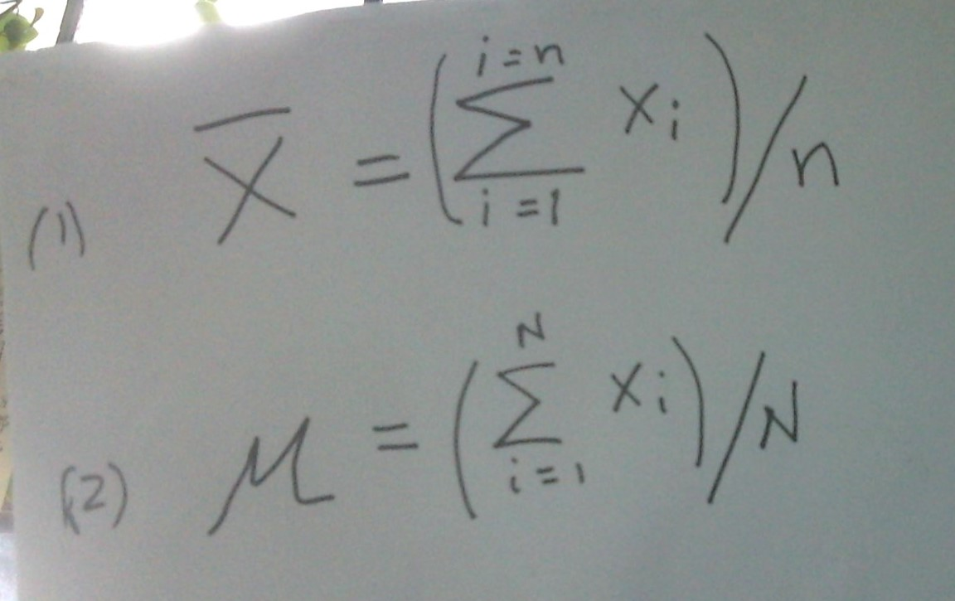
Sample and population mean

Slide 4
Mean: comments
The calculation for the mean for a sample or a population are identical.
Find the sum of all the values, and then divide the sum by the number of values (cases).
The only difference is the notation: μ (“mu”) and N are used for the population parameter; X-bar and n are used for the sample statistic.

Slide 5
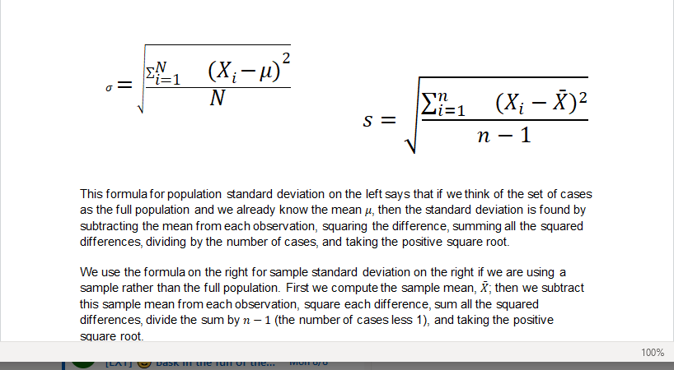
Variance and Standard Deviation

Slide 6
Standard Deviation: comments
The variance is the number we obtain with the formula before finding the SD by taking the positive square root.
The formulas for the population and a sample are slightly different in the division step (divide by (n – 1) for the sample).
When you use an online calculator, decide if you want the sample or the population SD.

Slide 7
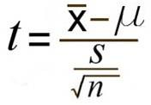
T-test

Slide 8
T-test: comments
In this formula X-bar is the sample value (could be a mean or the proportion for a binary with 0/1 codes).
Mu is a test value: usually if this is an independent samples t-test, mu is set at 0 (which means “no difference” in the outcomes for the two samples). Or mu could be a test value in a story problem.
The denominator is the standard error of the difference. If there are two samples with different sizes and/or variances, this value takes additional calculation—see the text.

Slide 9
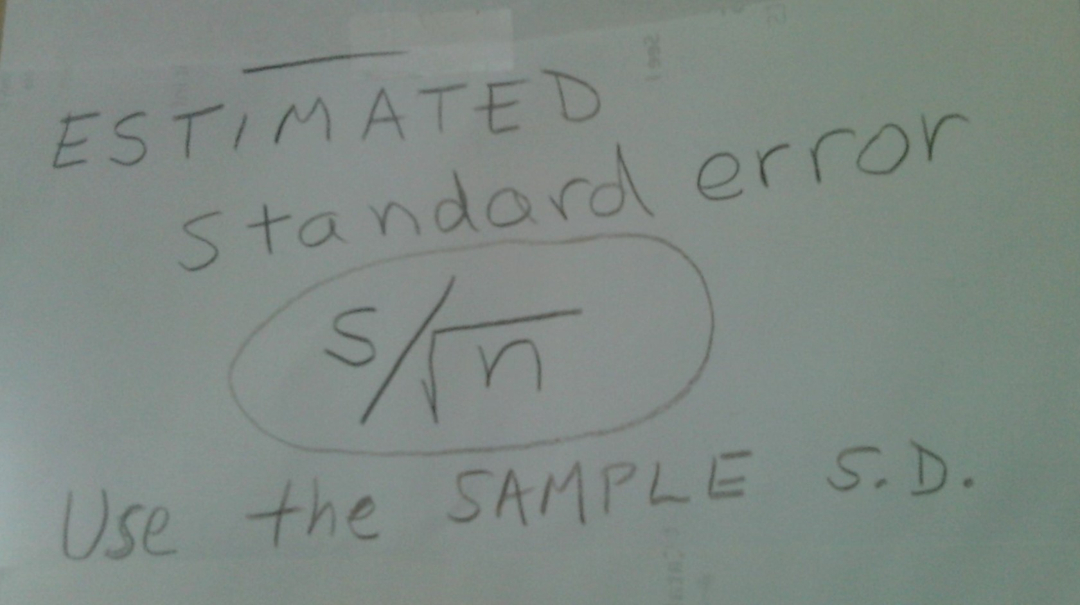
Estimated standard error

Slide 10
Estimated standard error
The estimated SE is the estimated standard deviation of the sampling distribution, not of the real (“empirical”) variable.
Note: sample size makes a difference. Remember to divide by the SQUARE ROOT OF SAMPLE SIZE.
When we estimate the standard error from the SD of the sample, we should use the t-distribution for our hypothesis test and confidence interval.

Slide 11
Regression
The next slides show formulas that are part of linear regression analysis—a linear model, involving the ordinary least squares regression line.

Slide 12
Pearson Correlation Coefficient
r = [Σ (Zx Zy)]/n
The best way of thinking about r is as the pair-wise product of the Z scores for each case, summed up for all the cases and then divided by the number of cases.
“The average product-moment.”
The big Sigma here is the summation operator, telling us to sum up all of the Z-score products.

Slide 13
What happens when we multiply the z-scores for each case?
If the variables line up positively (more of one, more of the other), the product of the Z-scores will be large and positive; r close to +1. (Note: positives go with positives, negatives with negatives, so the product is positive.)
If the variables line up negatively (more of one, less of the other), the product of the Z-scores will be large and negative; r close to -1. (Positives are paired with negatives; the product is negative.)

Slide 14
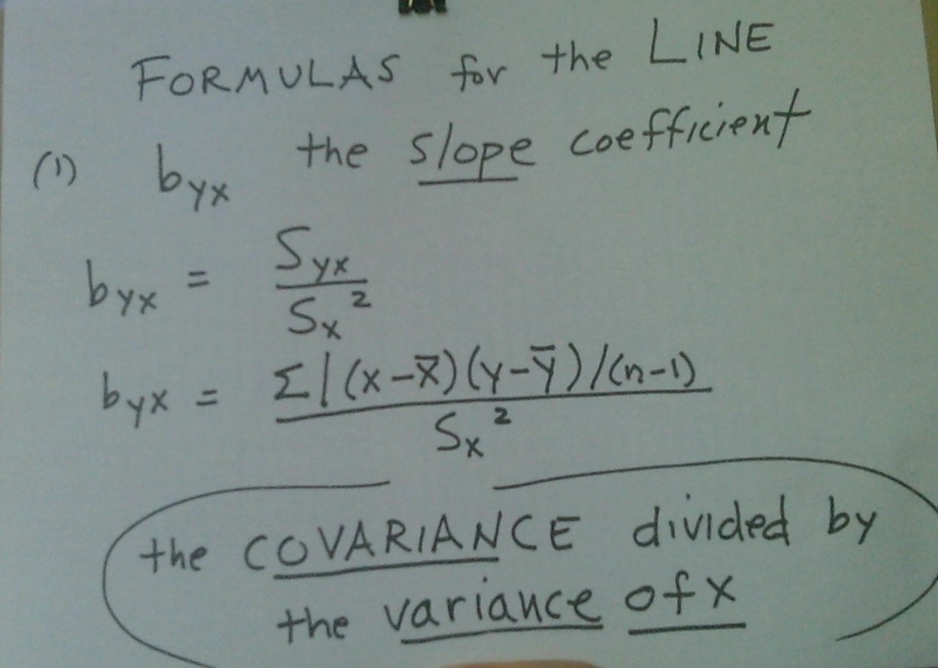
Regression line: slope coefficient

Slide 15
Regression line: slope for Y regressed on X
This formula is based on dividing the covariance of X and Y by the variance of X.
How much do the two variables vary together, for change in the X variable?
Notice it makes a difference which variable we designated X and which Y. This formula is not symmetric.

Slide 16
Constant term
Once we have calculated b, the slope coefficient (preceding slides), we can use it in a formula with the mean of the X distribution and the mean of the Y distribution to find the constant term of the equation of the ordinary least squares line. Remember that b in this formula is the slope for “Y regressed on X.”
NEXT SLIDE PLEASE!

Slide 17
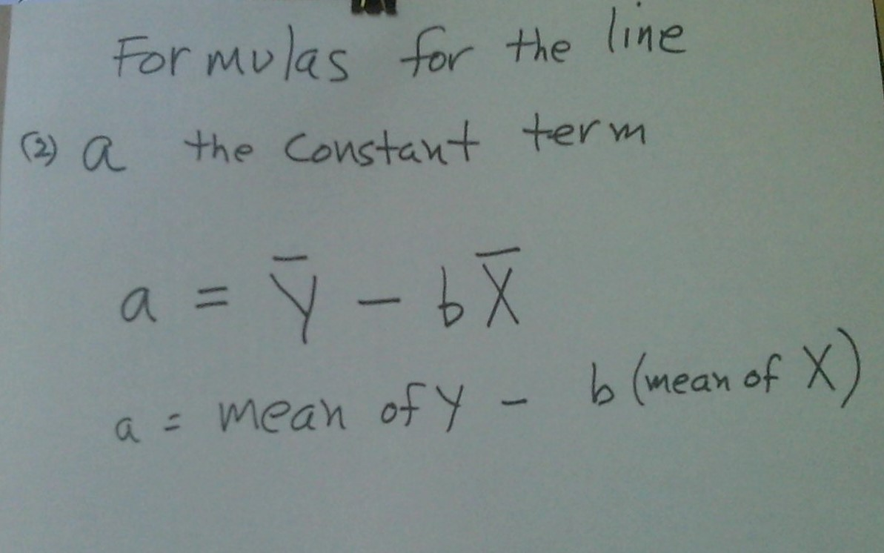
Regression: the constant term

Slide 18
R-squared
R-squared is a Proportional Reduction in Error measure that tells us how good our linear model is—how much of the variation in Y was predictable from information about the variation of X.
The easy way to get it is to square r, the Pearson correlation coefficient.
The next slides show us more about how the formula for R-squared is derived as the ratio of “regression variance” to “total variance.”

Slide 19
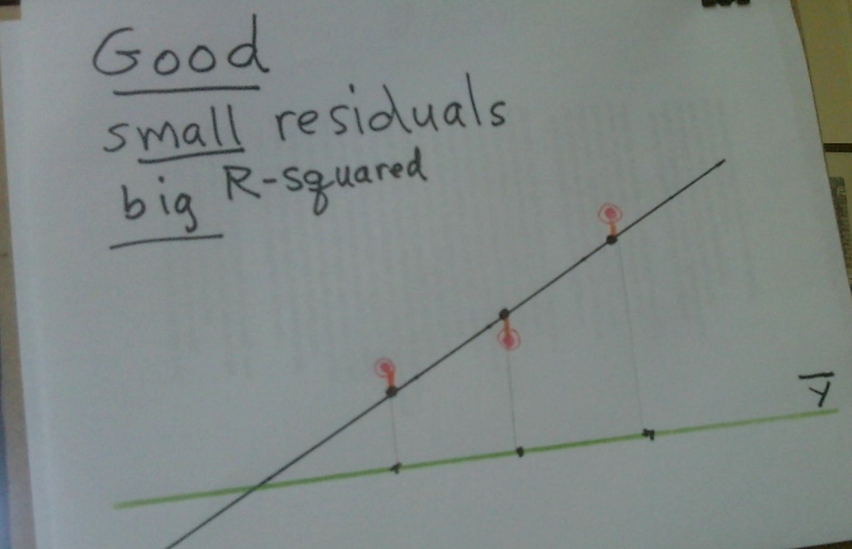
R-squared: good/regression variance

Slide 20
Regression variance—“good”
In the preceding slide, you can see that for each X, the estimated Y is pretty close to the regression line.
Using information about variation from the mean in the X variable, we were able to estimate Y values that are very close to the observed Y in our data (the red lines are short).
This situation gives us a high R-squared, close to 1 (its maximum).

Slide 21
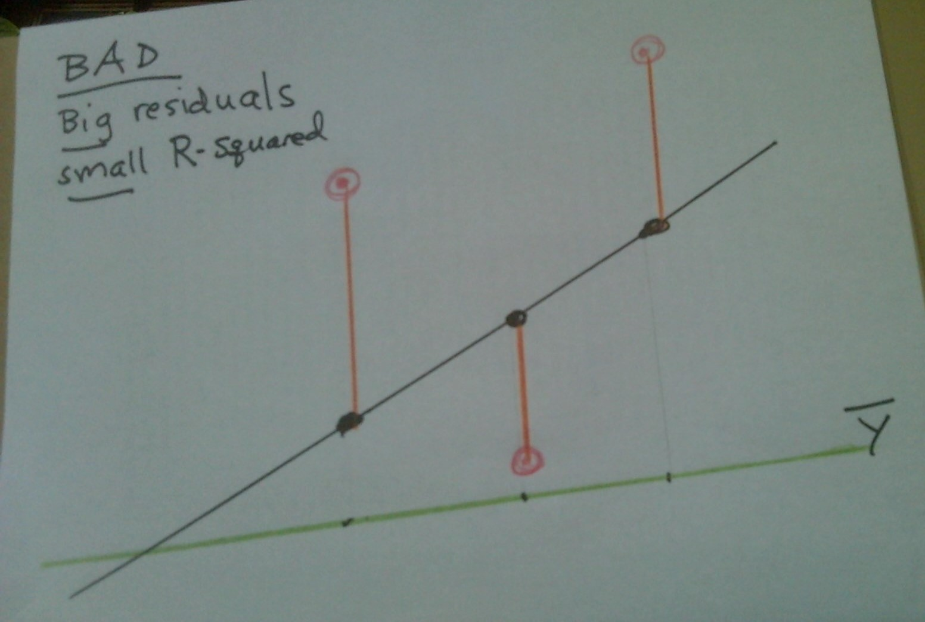
Regression variance—“bad”–big residuals!

Slide 22
A low R-squared
In the previous slide you can see a situation that produces a low R-squared. The residuals are big—the observed Y in the data is generally very different—way off the mark—from our estimated Y on the regression line.
There is a lot of variance in Y that is NOT accounted for by the regression model.
The X variable does not account for very much of the variation in the Y variable.

Slide 23
Chi-square calculation: Step 1
First, the expected values for the Null Hypothesis
We compute the expected count for each cell of the table with the formula:
  Expected count = (row total) x (column total)/n
So we look down the column at the column total (count); then we look across the row at the row total (count).
Then we multiply these two numbers together and divide by n.
The quotient is the expected value (count) for the cell.

Slide 24
Chi-square: Step 2
Second, calculation of the test statistic, chi-square.
That involves:
  Finding the difference between observed and expected counts in each cell
  Squaring that difference
  Dividing by the expected count
  Summing up all of these quotients for all of the cells.

Slide 25
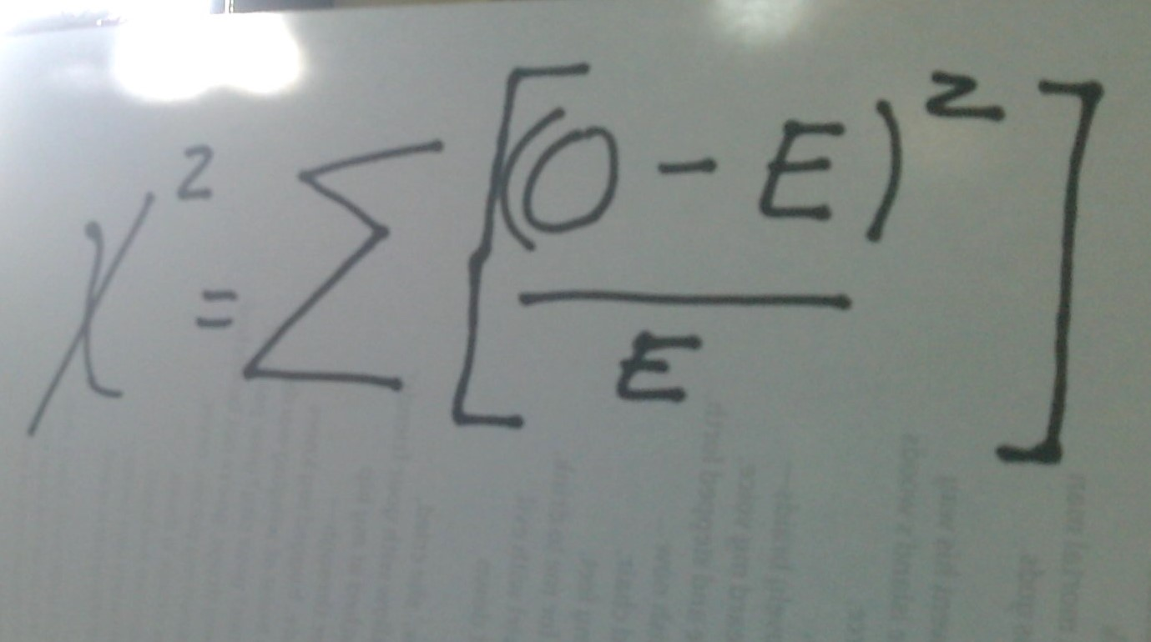
Chi-square formula

Slide 26
Formula explained
On the left side: the symbol that looks like an X squared is χ-squared, chi-squared, the test statistic for categorical data analysis.
On the right side: In each cell, we subtract expected count from observed count, square the difference, and divide by the expected count.
Then we sum the quotients for all the cells in the table. That is the value of chi-squared.
Look it up in the chi-square chart. (Degrees of freedom = (r -1)(c -1) where r and c are the numbers of rows and columns, NOT counting the totals.)
Big chi-squared…big discrepancy….low p-value….statistically significant: the DV distributions are different for different categories of the IV.

Slide 27
That’s all, folks!
For the ANOVA algorithm and formula, please see the text.
See also for details of how to compute the standard error for independent samples t-tests, when the sample size and variance of the two samples might be different.

